Slide 1
Partner customer story package framework
Customer overview (internal)
Customer highlight (external)
Customer quote (external)
Customer metrics summary (external)
Customer journey (external) / Partner -
Tech Partner: Better sales $ together (partner sales team)
Partner : Better together (why workato + partner)
Social media (external)

Slide 2


CUSTOMER OVERVIEW
Customer logo
Industry: IoT / Connected Operations
Region: North America
Size: 3,500+ employees
Co solution: Large-scale Jira migration with parallel job processing and automated commenting
Connecters: Jira Cloud, Atlassian Gov Cloud
Notes:
Background of customer
Summary of partnership

Slide 3

Atlassian Gov Cloud Migration:
400,000 Jira Comments in 10 Hours
The Challenge
Samsara needed to migrate their entire company from Jira Cloud to Atlassian Gov Cloud. The task seemed simple: leave a comment on tickets from the last year pointing to the new location on AGC. However, the original JQL query returned about 400,000 results. Due to Jira API limits, these had to be handled in batches of 5,000 or less - a massive undertaking that required precision.
Industry: IoT / Connected Operations
Region: North America
Size: 3,500+ employees
Orchestrating: Large-scale Jira migration with parallel job
processing and automated commenting
Connecters: Jira Cloud & Atlassian Gov Cloud
The Solution
Enter Workato. The engineering team chose Workato for its robust job logging, tables functionality, and ability to rerun jobs - critical features for such a large endeavor. They divided the data day by day to keep queries under 5,000 results, then set up a function to asynchronously call their comment function for each day in the range, firing off multiple jobs in parallel. The platform's reliability and ease of setup compared to alternatives like AWS made it the clear choice.
"In my experience, this is the hardest I've ever pushed Workato as a platform, and it was a breeze. 10/10 would choose again."
400,000
Jira comments posted successfully across the entire migration
10 hours
total migration processing time with zero manual intervention required
Zero errors
or failures throughout the entire migration process
Seamless
handling on API rate limits on parallel job processing
Kevin Bay, Engineer at Samsara
CUSTOMER HIGHLIGHT
Notes:
Seller script here >

Slide 4
“ In my experience, this is the hardest I've ever pushed Workato as a platform, and it was a breeze. 10/10 would choose again. ”
Kevin Bay
Engineer
Samsara
CUSTOMER QUOTE
Notes:
Seller script here >

Slide 5
Atlassian Gov Cloud Migration:
400,000
Jira comments posted successfully across the
entire migration
Zero errors
or failures throughout the entire migration process
10 hours
total migration processing time with zero manual intervention required
Seamless
handling on API rate limits on parallel job processing
CUSTOMER STATISTICS
Notes:
Seller script here >

Slide 6

The Modernization Journey at
RPA
Data Orchestration
APIM
iPaaS
MCP
Agentic Platform
Agents
Retire
UI Path
FiveTran
Reduce
MuleSoft
Workato
CUSTOMER JOURNEY
Notes:
Visualize the workday (tech vendor) vs workato pieces…

Slide 7
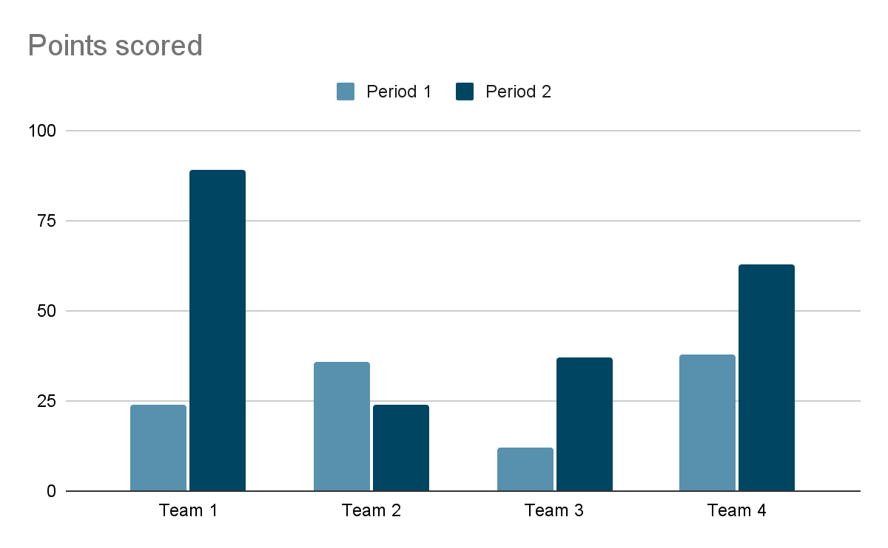
Tech alliance slide. Before and after workato
Total sale to customer increases when including Workato!
BETTER TOGETHER

Slide 8
Social media and promotion
LinkedIN copy w/tracked URL
Twitter copy w/tracked URL
Social Graphic
SOCIAL COPY AND GRAPHICS

Slide 9
appendix

Slide 10
Sales win slides

Slide 11
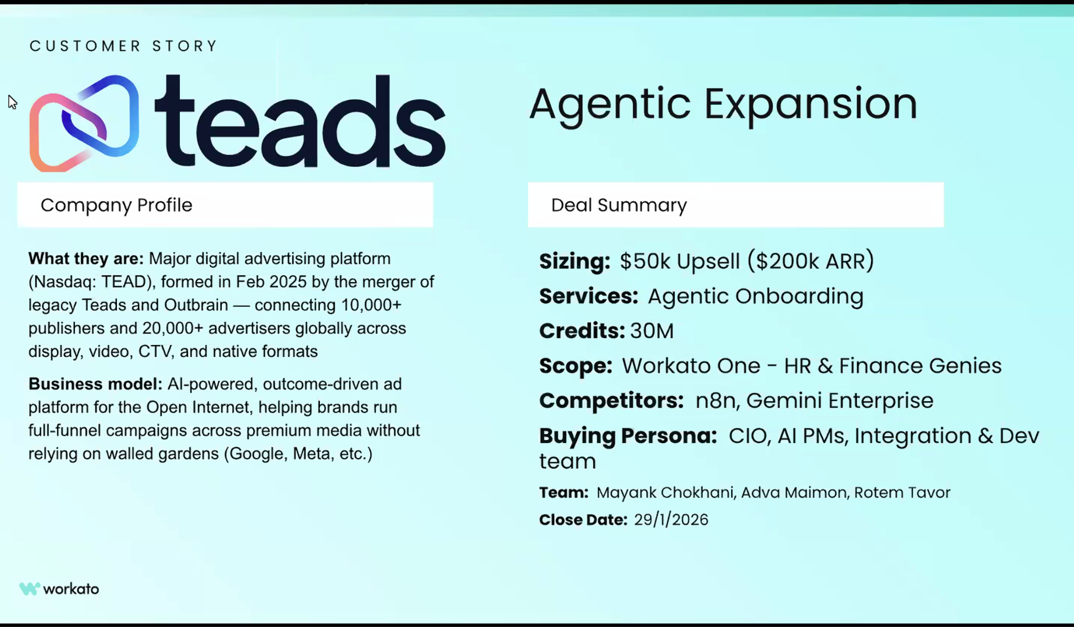

Slide 12
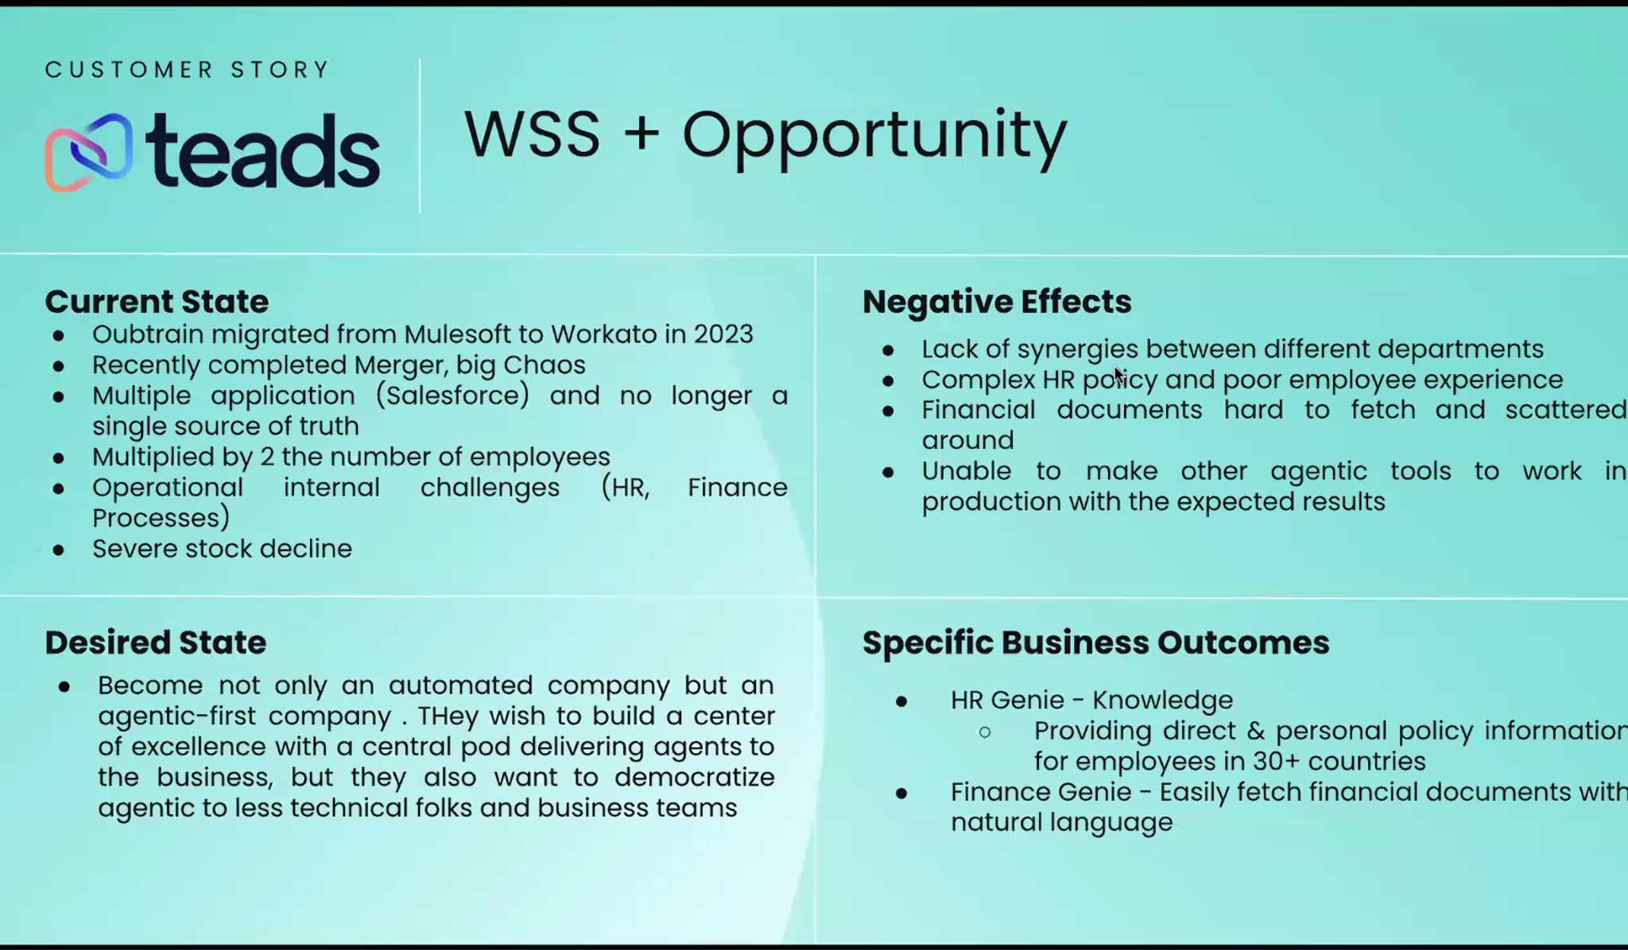

Slide 13
